Slide 1


Data structures and Algorithm
. . .

Slide 2

Project: Student Management
. . .

Slide 3

Based on scenario
In my role as an in-house software developer for Soft Development ABK, a software studio specializing in serving small and medium-sized businesses, I was tasked with designing and developing a student management application. The goal of this application is to help users easily manage student information, including ID, name, and scores.

Slide 4
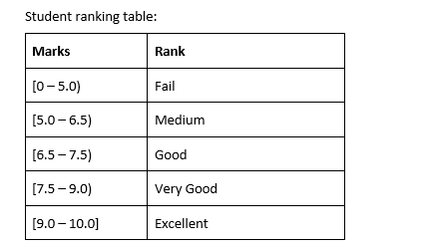
Based on scenario
The application will allow users to enter the number of students to manage and automatically classify students based on their scores according to a specific ranking. This ranking will help users quickly evaluate students' academic results, from "Fail" to "Excellent".
In addition, the application will also support functions such as adding, editing, deleting and searching student information, facilitating data management. I was also asked to propose an alternative algorithm and evaluate the effectiveness of the algorithm used previously, to optimize the student management process.

Slide 5
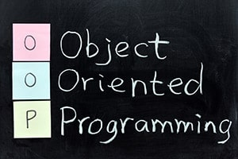

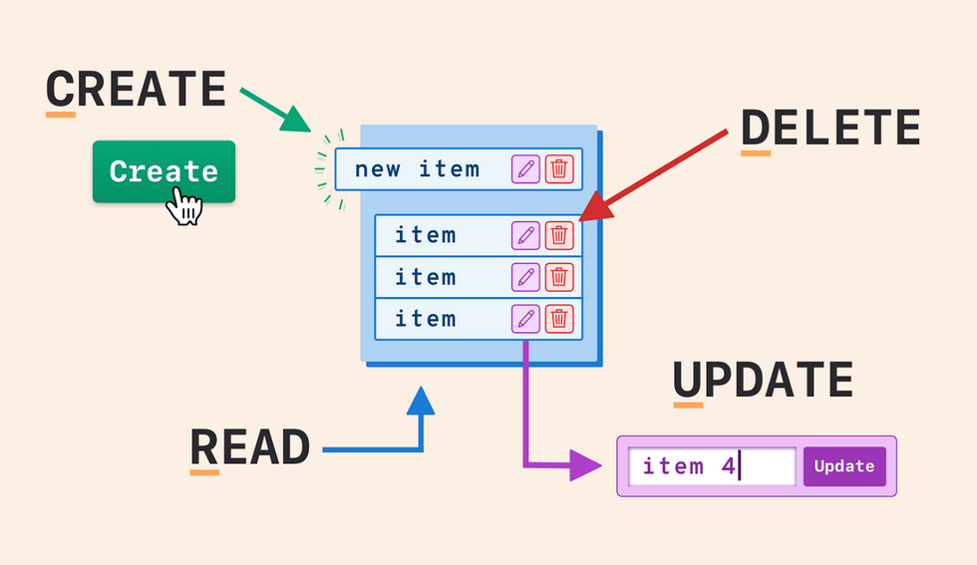
Knowledge Applied in Deploying Source Code "Soft Development ABK"
Object Oriented Programming (OOP)
Using ArrayList
CRUD Method
Use classes like Student, ArrayListAddStudent, ArrayListEditStudent, ArrayListRemoveStudent, and ArrayListSearchStudent to organize code.
Apply ArrayList to store and manage student lists, allowing flexible manipulation.
Implement methods such as addStudent, edit Student, removeStudentById, and binarySearch to perform CRUD operations (Create, Read, Update, Delete).

Slide 6



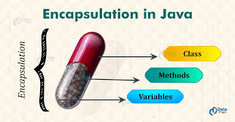
Knowledge Applied in Deploying Source Code "Soft Development ABK"
Binary Find
Compare and Sort
Handling Conditions and Classification
Encapsulation and Data Security
Use binary search algorithm in ArrayListSearchStudent class to search students by ID.
Use Comparator to define how to compare Students by ID, full name and score.
Use the if-else conditional structure in the Student class to sort students by score.
Apply the principle of encapsulation with getter and setter methods to the Student class property

Slide 7
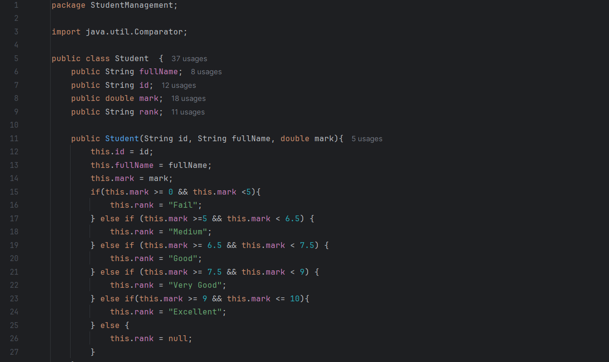
Deploying the Code After Applying the Knowledge
Student Class
Start with the Student class, since this is the base class for all student objects. It defines the required properties and methods.

Slide 8
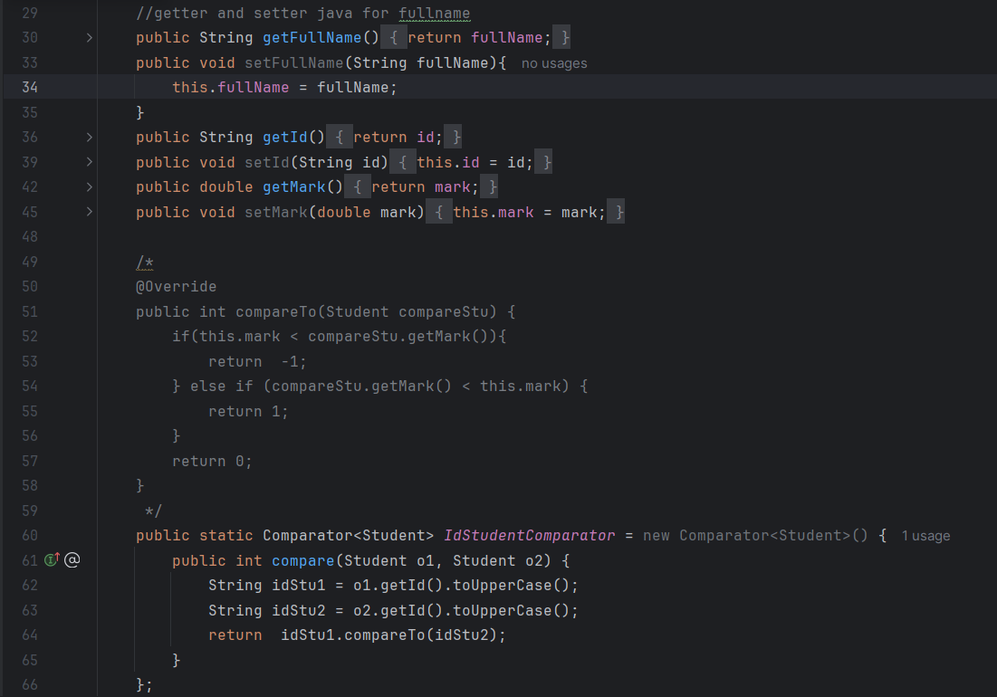
Deploying the Code After Applying the Knowledge
Student Class
Start with the Student class, since this is the base class for all student objects. It defines the required properties and methods.

Slide 9
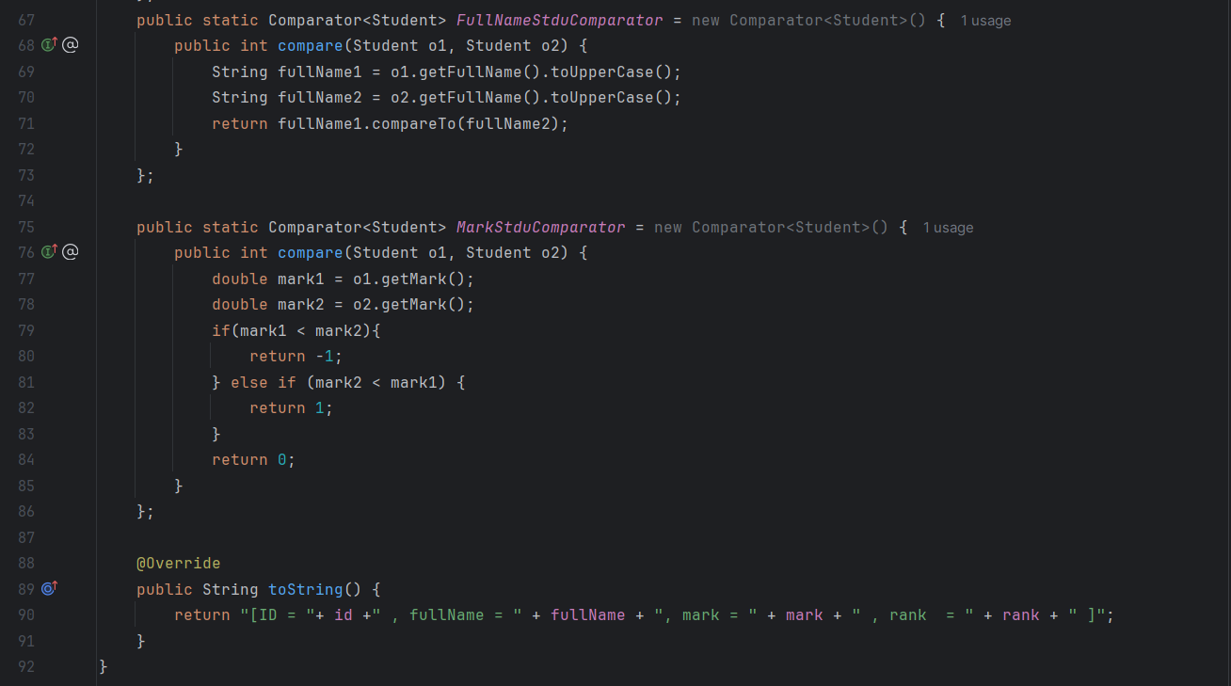
Deploying the Code After Applying the Knowledge
Student Class
Start with the Student class, since this is the base class for all student objects. It defines the required properties and methods.

Slide 10
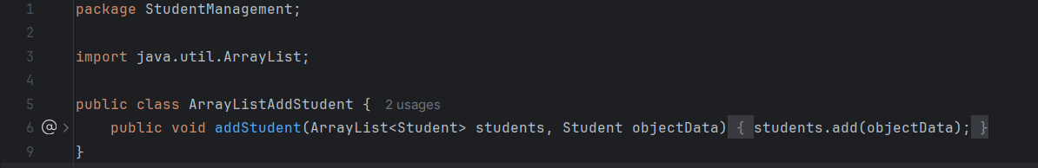
Deploying the Code After Applying the Knowledge
ArrayListAddStudent Class
Next, present the ArrayListAddStudent class, which will use the Student class to add students to the list.

Slide 11
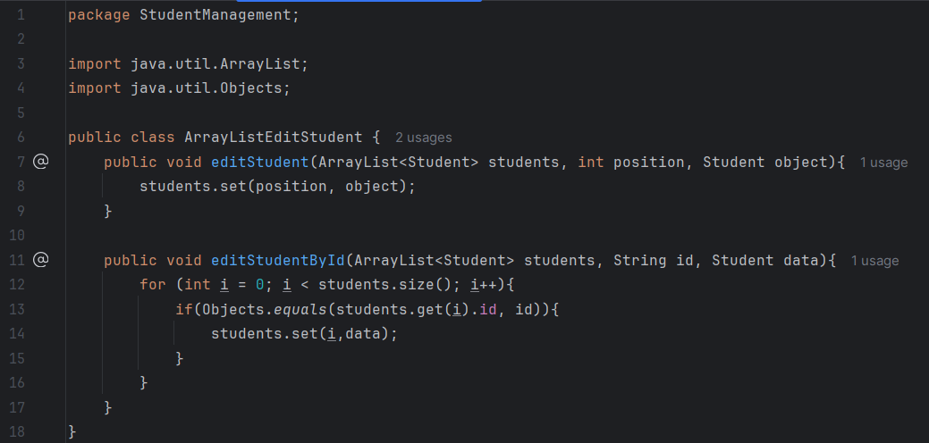
Deploying the Code After Applying the Knowledge
ArrayListEditStudent Class
Then, introduce the ArrayListEditStudent class, which allows editing of student information that has been added.

Slide 12
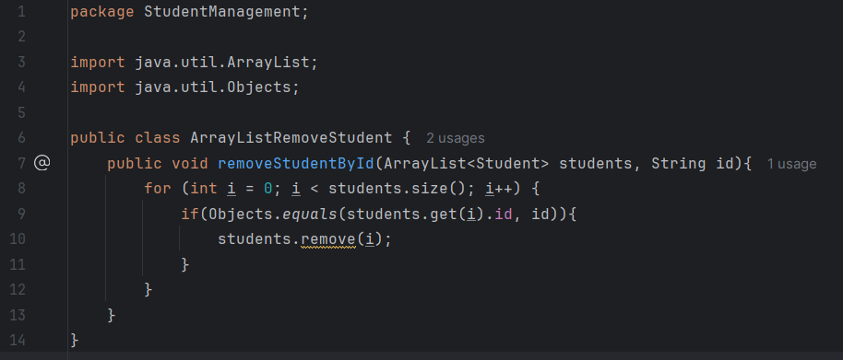
Deploying the Code After Applying the Knowledge
ArrayListRemoveStudent Class
Next is the ArrayListRemoveStudent class, which performs the function of removing students from the list.

Slide 13
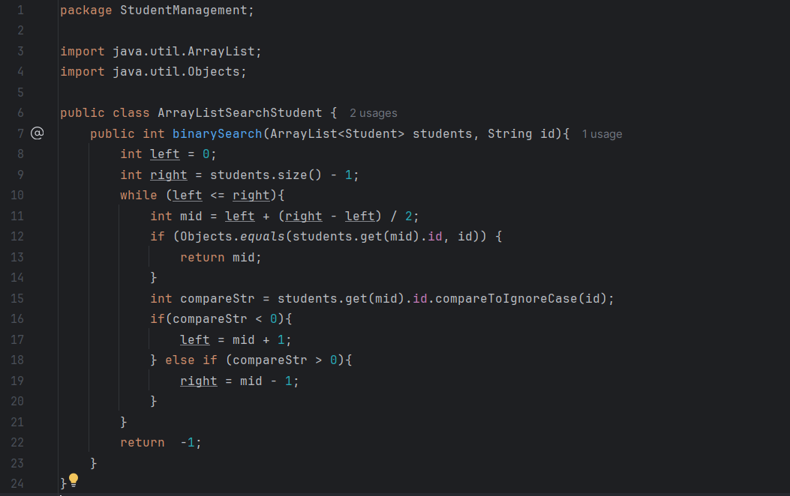
Deploying the Code After Applying the Knowledge
ArrayListSearchStudent Class
Then, present the ArrayListSearchStudent class, which allows students to be searched in the list.

Slide 14
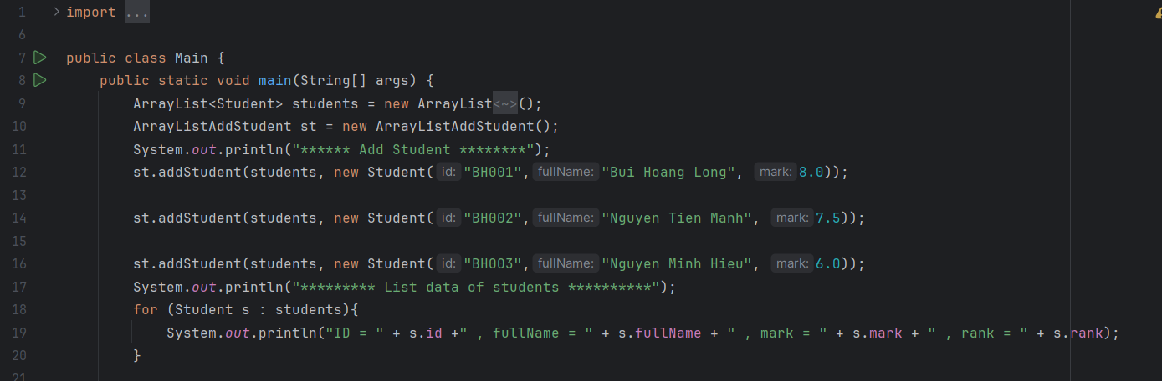
Deploying the Code After Applying the Knowledge
Main Class
Finally, end up with the main program, where all the classes are instantiated and functions are called for user interaction.

Slide 15
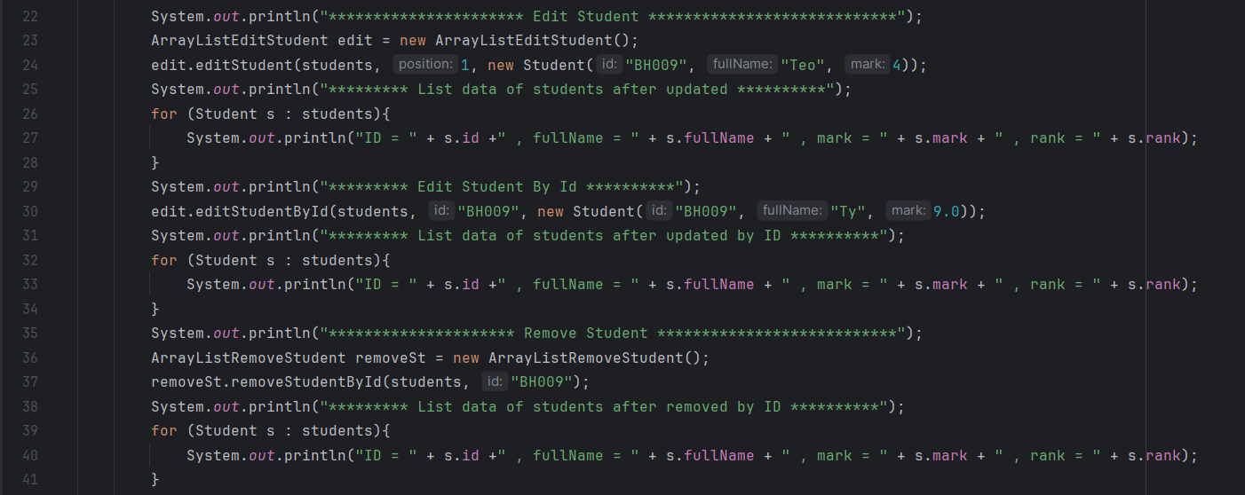
Deploying the Code After Applying the Knowledge
Main Class
Finally, end up with the main program, where all the classes are instantiated and functions are called for user interaction.

Slide 16
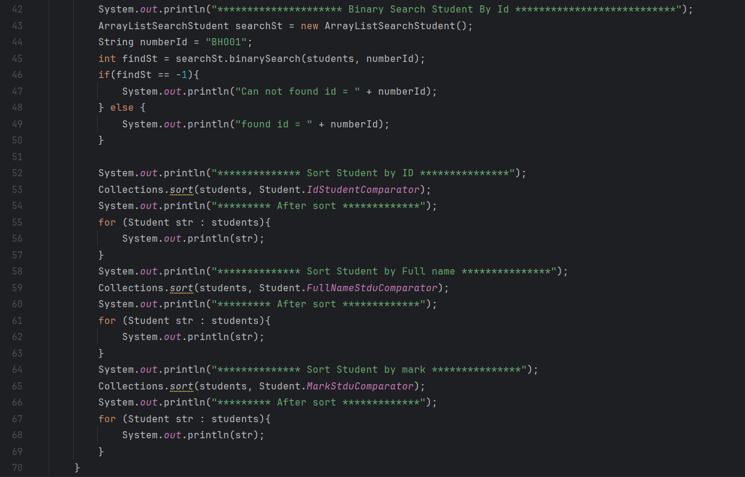
Deploying the Code After Applying the Knowledge
Main Class
Finally, end up with the main program, where all the classes are instantiated and functions are called for user interaction.

Slide 17
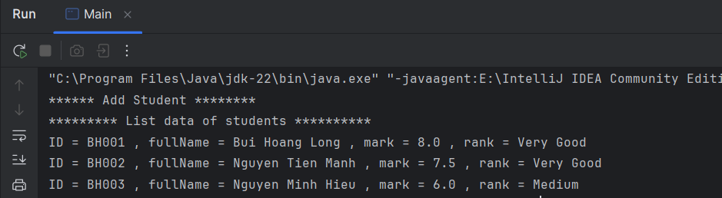
Result After Running the Application

Slide 18
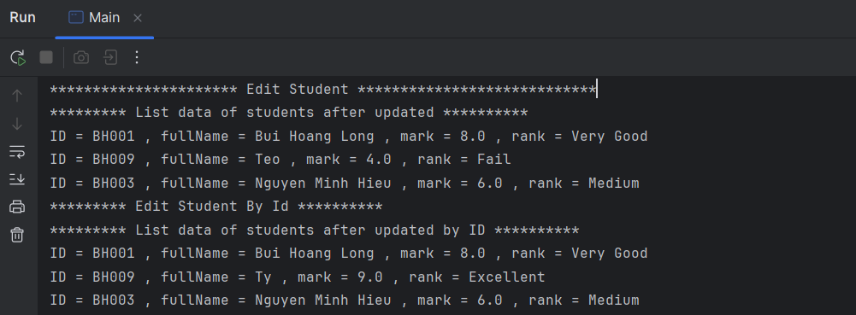
Result After Running the Application

Slide 19
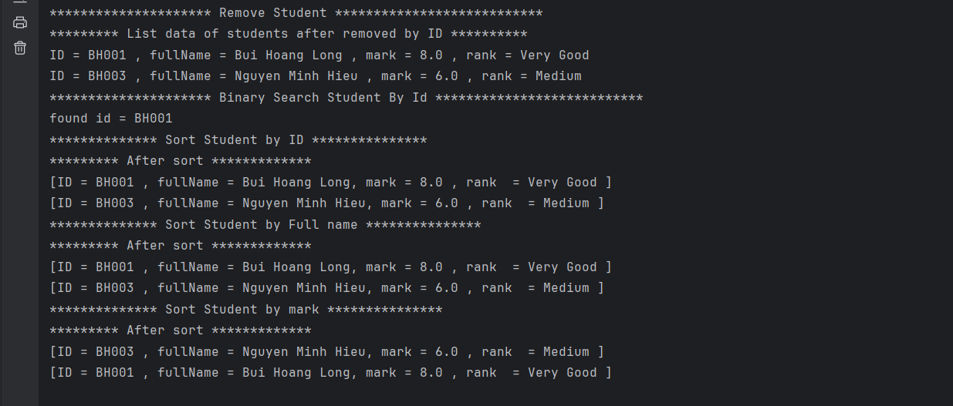
Result After Running the Application

Slide 20
Conclusion
During the process of developing a student management application, we gained many valuable insights. Using object-oriented programming helps organize code in a clear and easy-to-maintain manner. The application allows adding, editing, deleting and searching student information effectively, demonstrating flexible data management capabilities. We also learned how to solve challenges that arise creatively, thereby improving our problem-solving skills. Finally, the project is not only academic in nature but can also be practically applied to manage student information at educational institutions.

Slide 21

Thank you!

